Slide 1
Walmart Stores and U.S. Neighborhoods
Diana Dinshaw
Erica Merza
Kristi Bischoff
Rose Chakkoria

Slide 2
Background
One of the largest retailer’s consisting of about 11,000 locations worldwide
Wide range of products and competitive pricing
A source of many jobs and sales
In year 2017:
Example: 38,000 employees in New York state
362 billion in sales
About 260 million shoppers per week
Constantly expanding with locations
Is there a pattern with geography, income level, and locations?
Source: https://www.newsday.com/business/walmart-facts-first-store-in-u-s-sam-walton-yearly-sales-smiley-and-more-1.13811374

Slide 3
Hypothesis
In the United States, the concentration of Walmart and subsidiaries in low and middle income zip codes are greater than higher income zip codes.

Slide 4
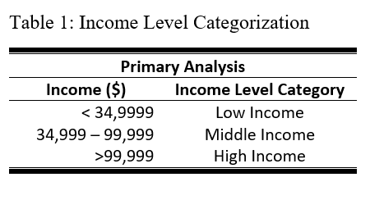
Methods: Income level categorization
Source: https://www.thebalance.com/definition-of-middle-class-income-4126870

Slide 5
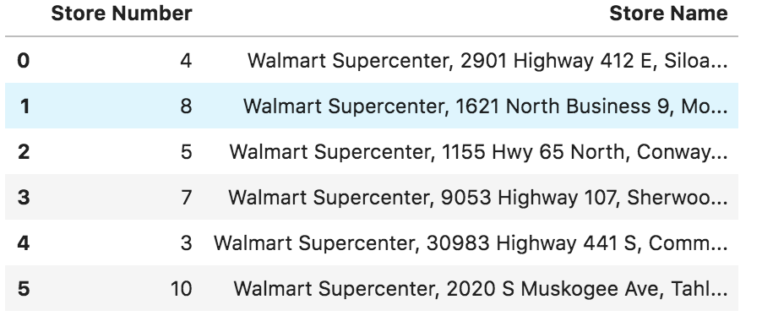
Methods: Data sets
Figure 1: Dataframe Example
Walmart Store Database – www.kaggle.com

Slide 6
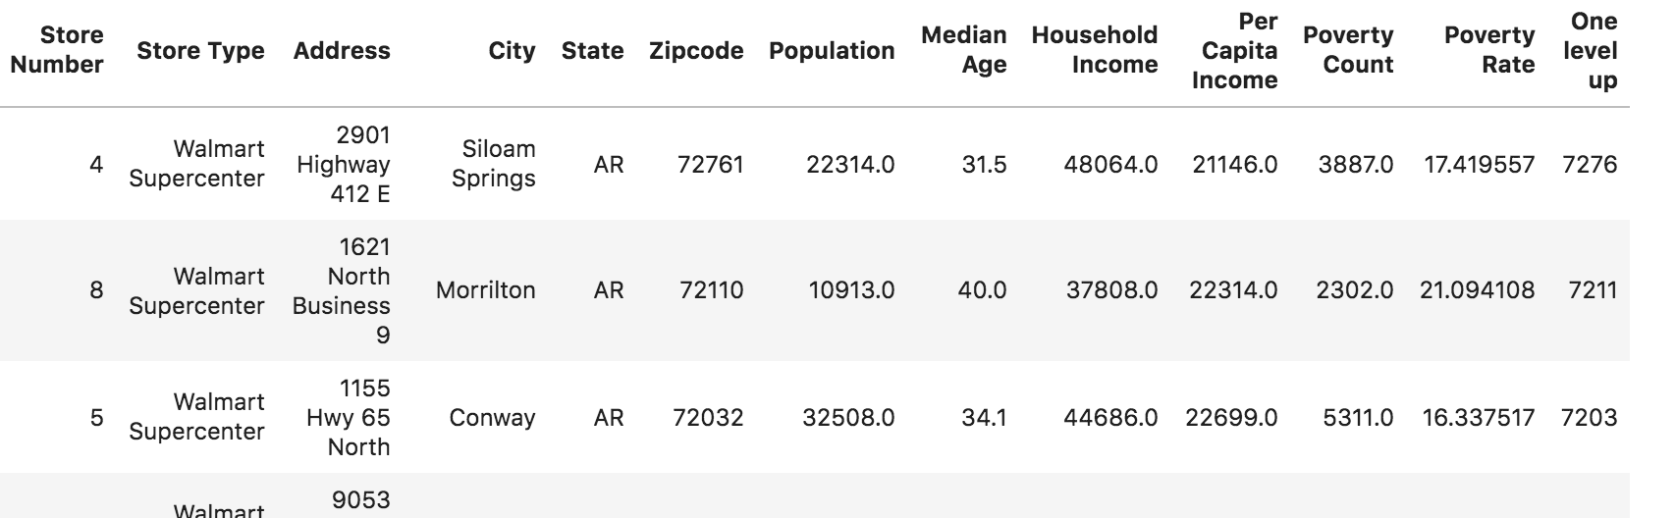
Methods: Data sets
Figure 2: Dataframe Example Continued
Census Data API– https://api.census.gov/

Slide 7
Analysis
Merged Walmart locations with Census Data
Calculated Poverty Rates
Obtained geographical locations (latitude and longitude)
Plots for frequencies
T test and One way ANOVA

Slide 8
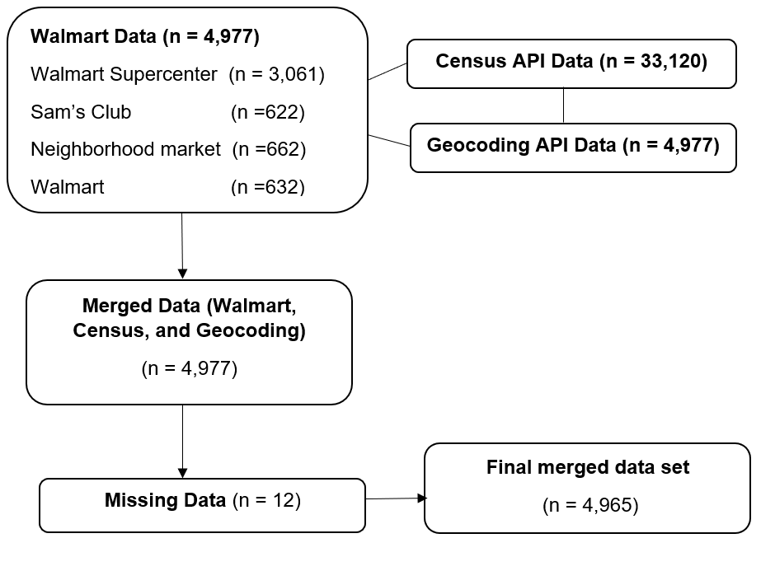
Workflow
Figure 3: Flowchart of data sets and sample sizes

Slide 9
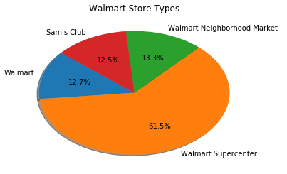
Results
Figure 4: Walmart Store Types
Multiple Walmart store “types”
Each type of Walmart differs in products and services
Most of the Walmart stores are Supercenter Walmarts
Does not require a membership
Offers a wide range of services
Houses a lot of jobs

Slide 10
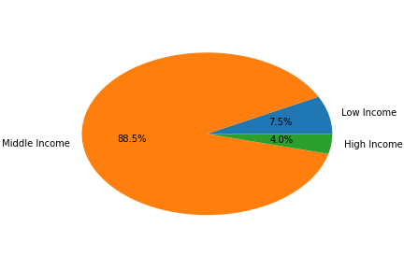
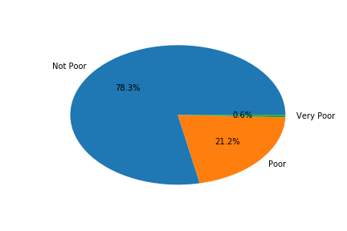
Results Continued
Figure 5: Income level frequency
Figure 6: Poverty level frequency
Low Income < 35k
Middle Income >35k and <100k
High Income >100k
Not Poor < 20% poverty
Poor >20% and <40%
Very Poor >40%
Source: https://definitions.uslegal.com/h/high-poverty-areas/

Slide 11
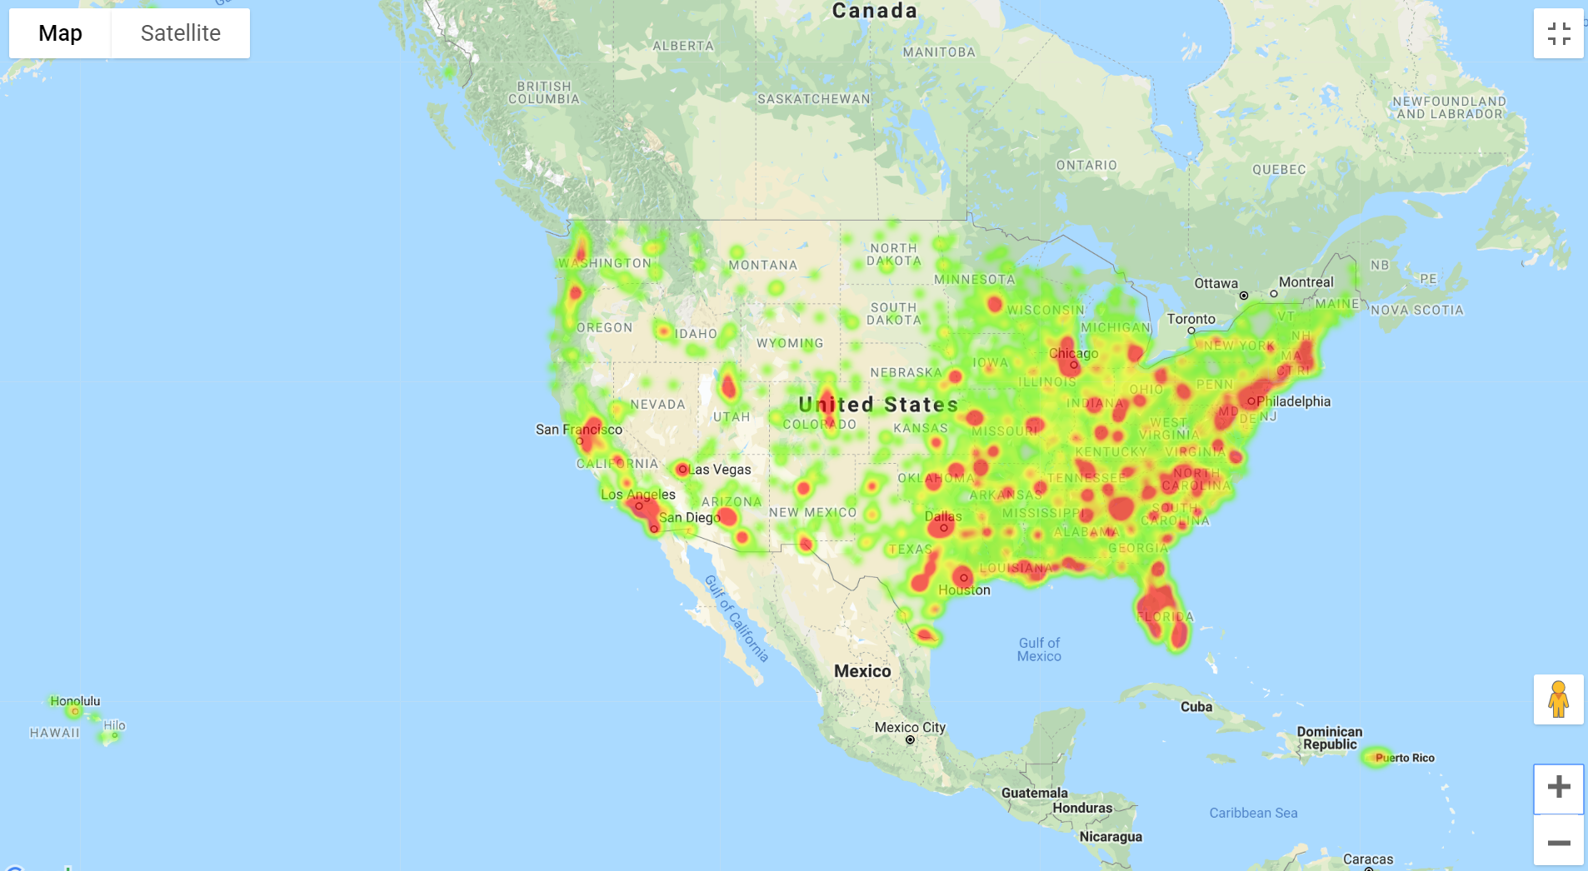
Results Continued
Figure 7: Heat map of Walmart store locations in the United States

Slide 12
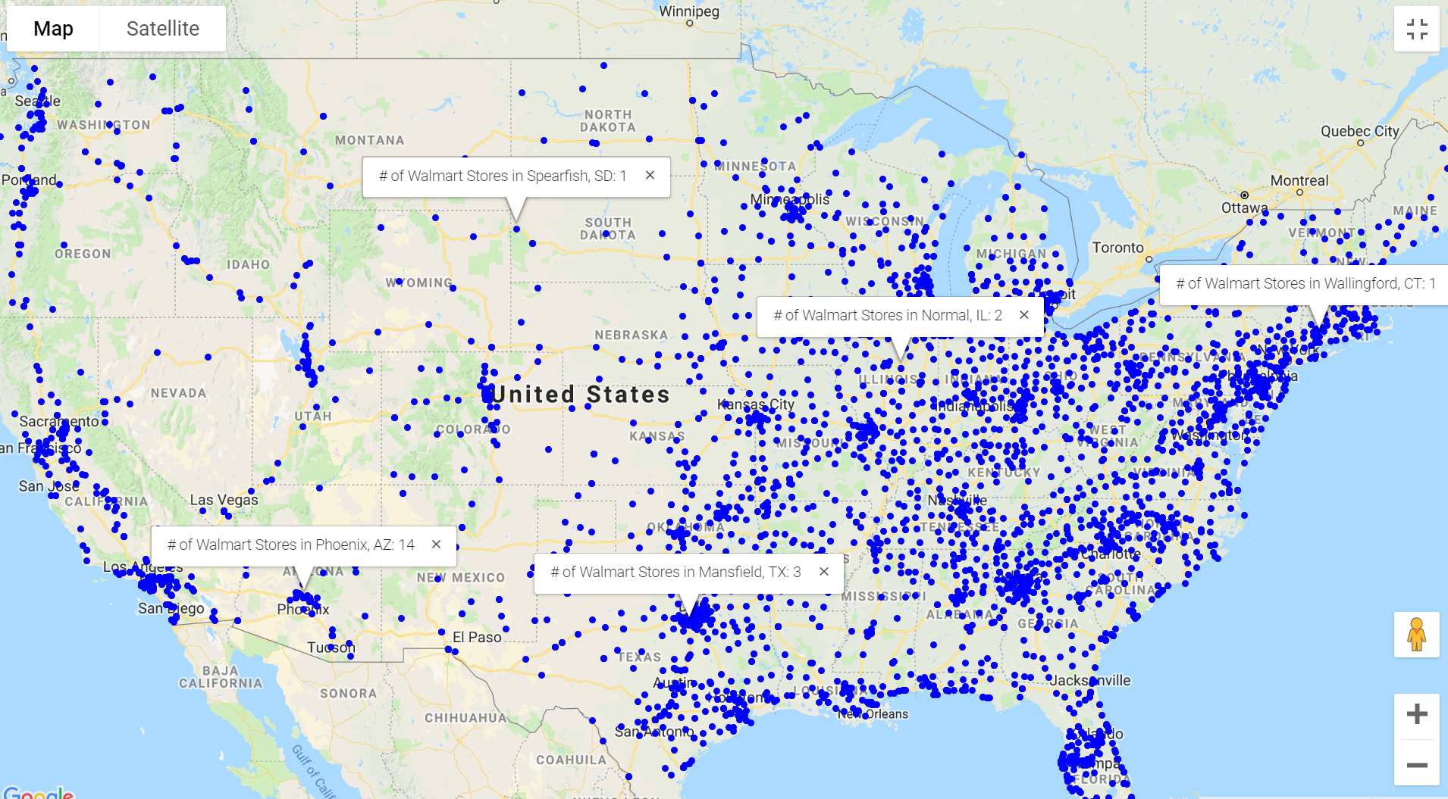
Results Continued
Figure 8: Map of Walmart locations in the United States showing # of stores in each city

Slide 13
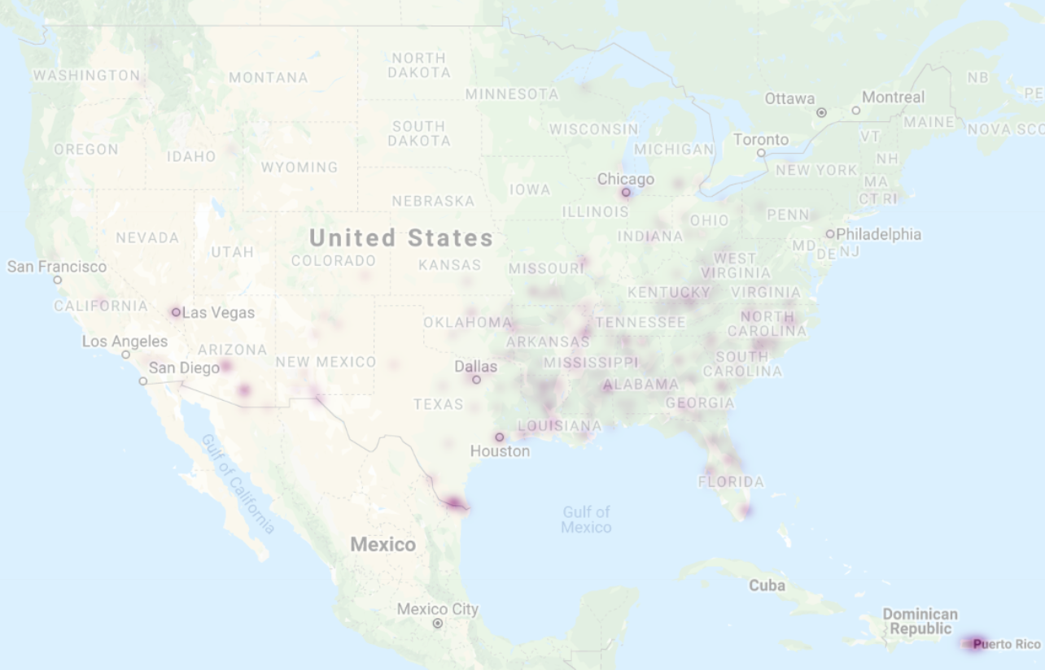
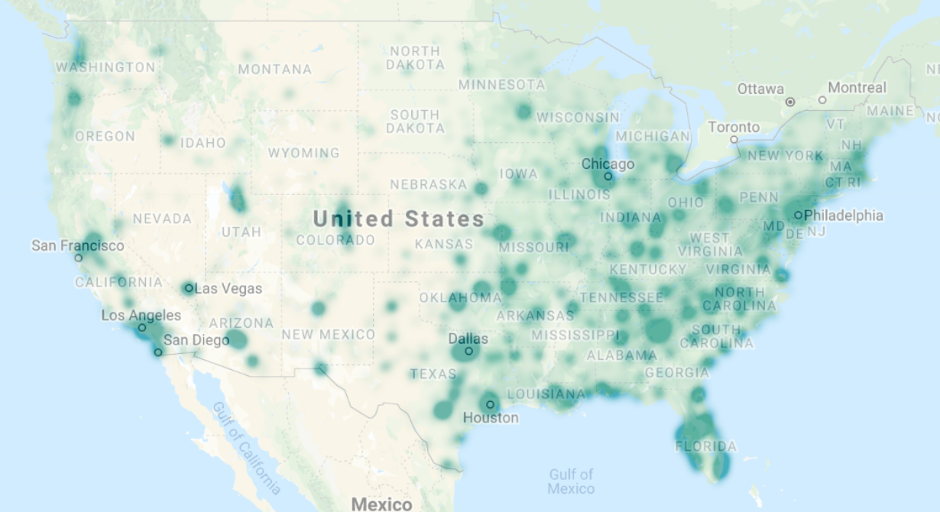
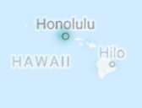
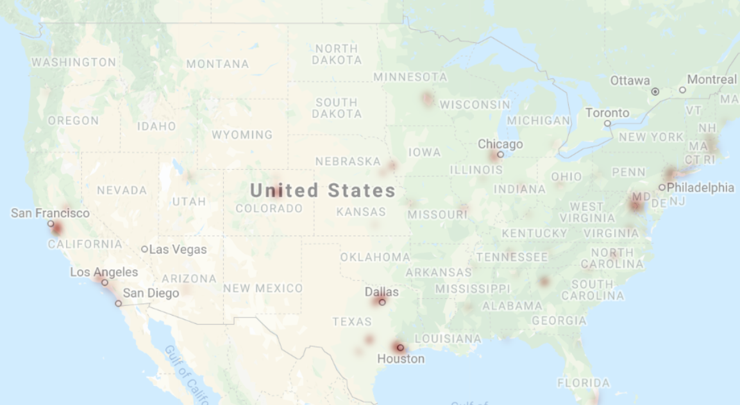
Results Continued
a
b
c
Figure 9a-c: Heat map of lowª, middle^{b}, and high^{c} income levels

Slide 14
Results Continued
Normal distribution
Independent observations
Data is homogenous
One Way ANOVA
Statistically significant differences between income categories and the number of Walmart’s
Lack of normality so performed a nonparametric test (Kruskal-Wallis)
Independent t test
Statistical significance difference in the household income for zip codes with 1 Walmart vs. more than 1 Walmart

Slide 15
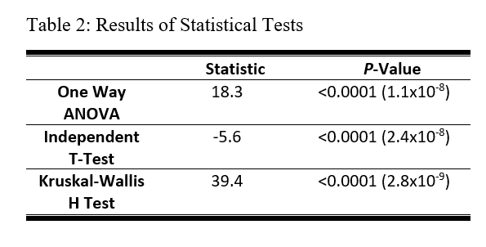
Results Continued
N total= 4,965
T test:
N (locations with 1 store) = 3368
Mean Income =$56k
N (locations with >1 store) = 1597
Mean Income =$59k
Anova:
N (low income) = 348
N (middle income) = 4418
N (high income) = 199
The sample distributions are not equal, so we reject the null hypothesis of equal income category sample distributions.

Slide 16
Conclusion
Our initial hypothesis of Walmart locations favoring low and middle income areas is partially true.
Through our analysis, we were able to uncover that there are more locations in zip codes that were categorized as middle income compared to low and high income categorizations

Slide 17
Discussion
Strengths:
Walmart dataset had all U.S. locations- not a sample population
Obtained location and census data for the same year
Use of APIs for most of the data (less cleaning issues)
Limitations:
We have used median income by zip code which may not represent of all of the individuals in a given area
gmaps documentation – limited documentation and examples

Slide 18
Future Analysis
Deeper analysis of larger metro areas with significant number of Walmart locations to further analyze the findings
Analyze how/if the Sam’s Club (Membership fee-Bulk Purchase Model) differ from locations branded as Walmart
Perform regression analysis to identify the association with the number of Walmart’s based on household income
Adjust for confounding and effect modification
Gender, age, education, and rural/urban designation
Identify other sources for income by zipcode to have a more accurate representation

Slide 19
Questions?

